Slide 1
General Psychology
Professor: Randall C. O’Reilly

Slide 2

This Class is All About You
Your brain
Your memories
Your fears
Your mental disorders
Your joys
Your friends (and the stuff they make you do..)
Your parents
…

Slide 3
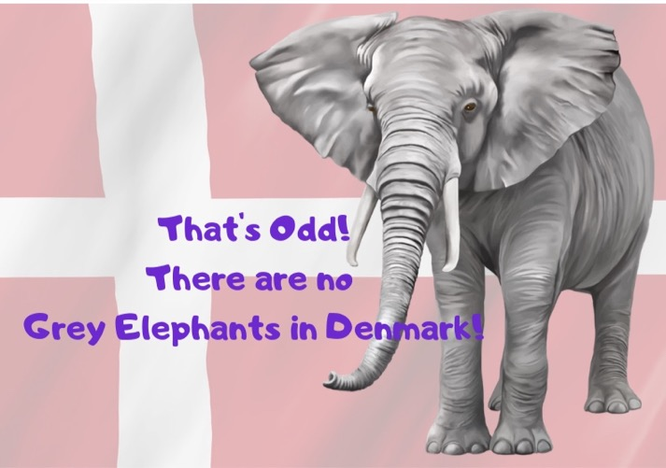
Who Are You?
Unique! (probably want to avoid younique..)
But your brain has a lot in common with others..
So we can make some pretty good guesses..

Slide 4
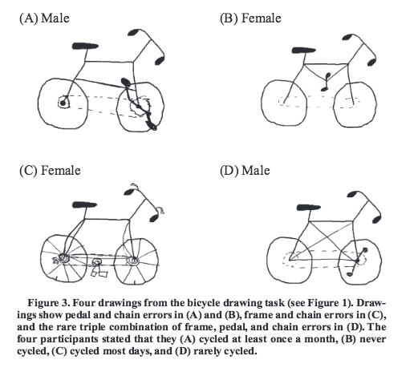
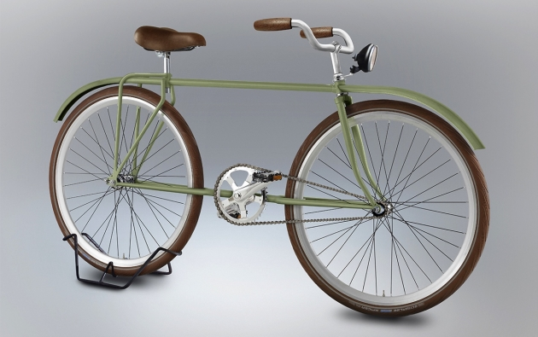
You Don’t Know Much..
Lawson, 2006
Sloman & Fernbach, 2018

Slide 5
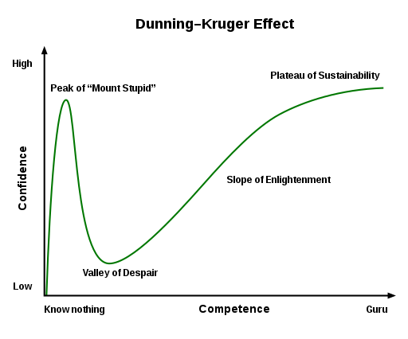
And you don’t know you don’t know.. (anosognosia of everyday life..)

Slide 6
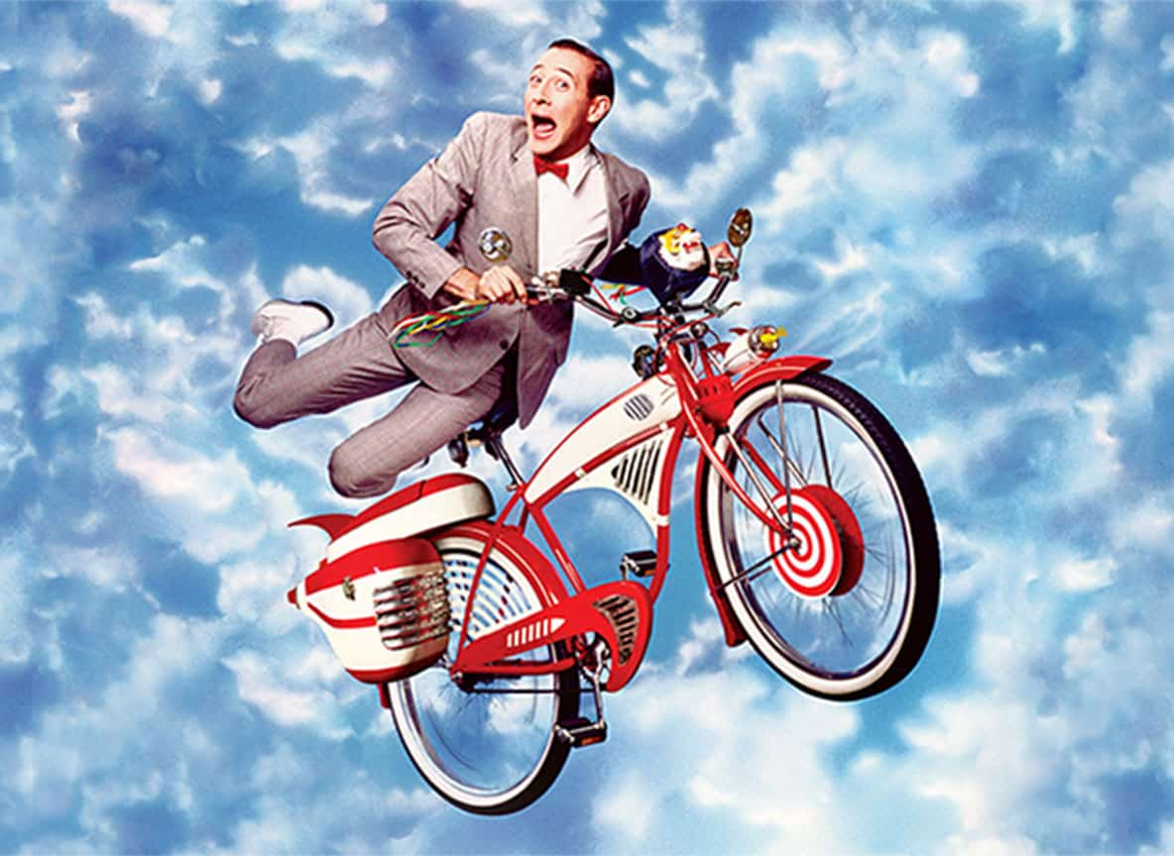
And it doesn’t really matter!!

Slide 7
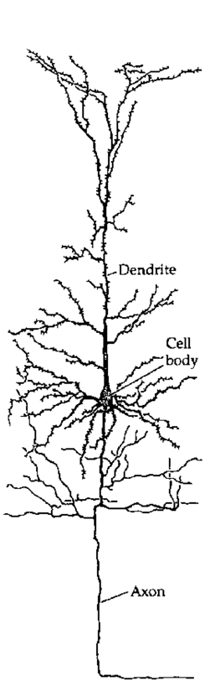
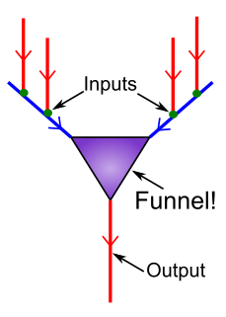
Your Brain is one big Funnel!
Tons of information slamming into you every millisecond!
But your brain just compresses everything into what you actually need to know!

Slide 8
Principle #1: Compression
Stereotypes
Tweets
Soundbites
Texting
(more pictures please!)

Slide 9
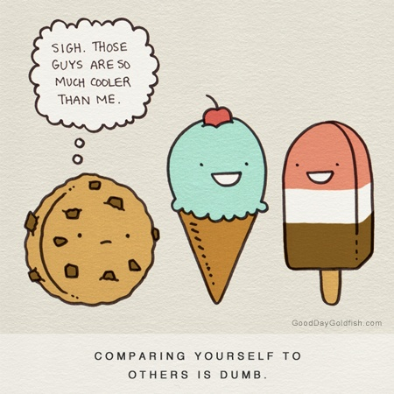
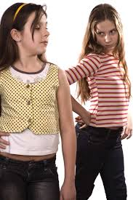

You are Constantly Comparing

Slide 10
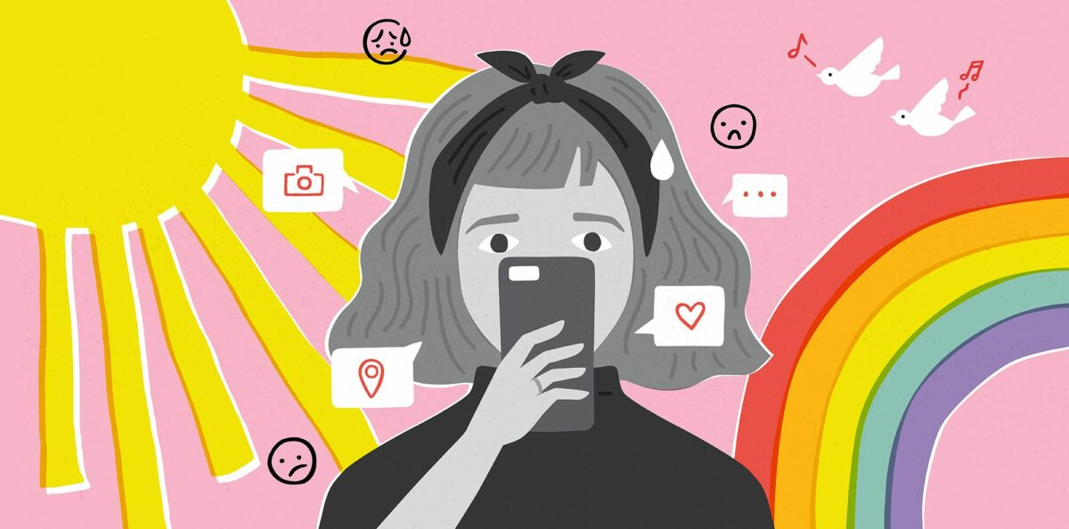

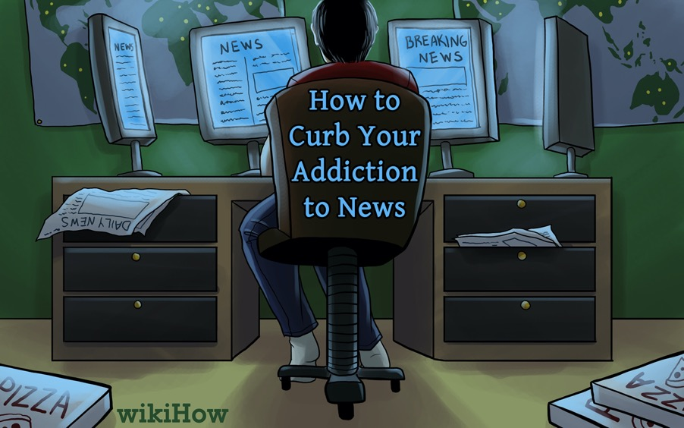
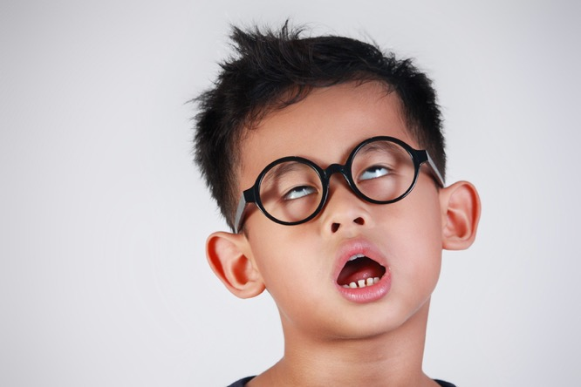
Constantly Seeking News
So Bored!!!

Slide 11
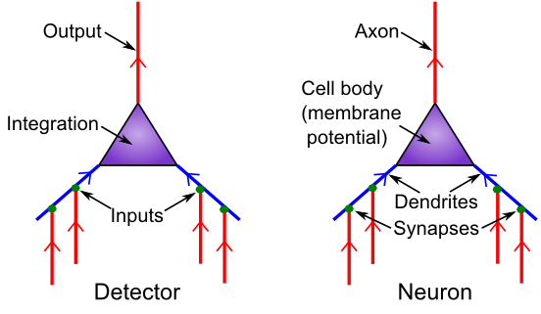
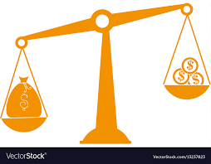
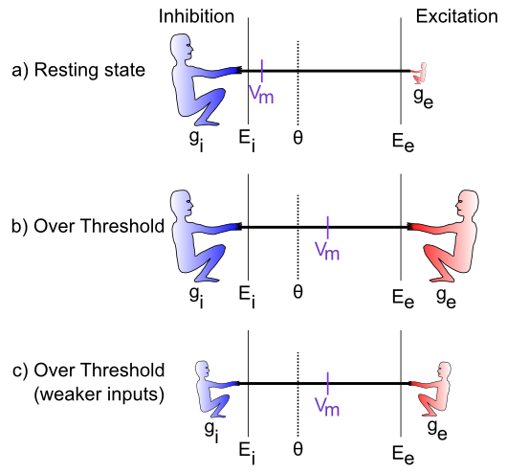
Principle #2: Contrast
Everything is always relative in your brain
Constantly comparing relative to everything
Including the past (news)

Slide 12
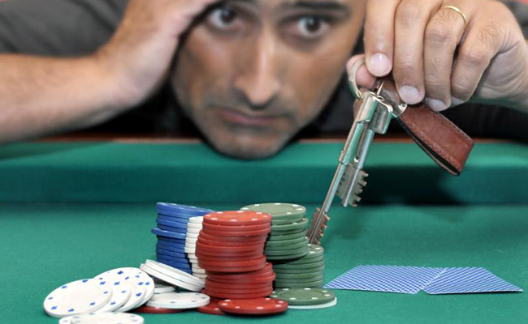
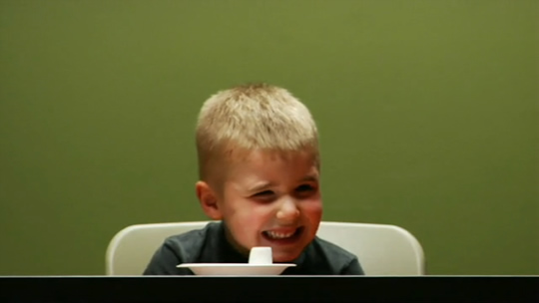
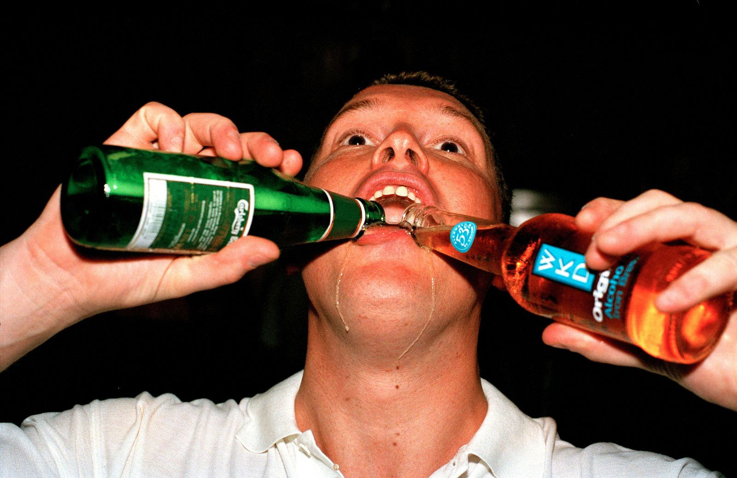
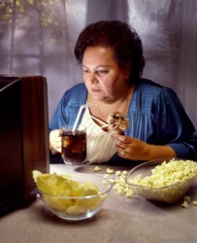
You struggle with Self Control

Slide 13
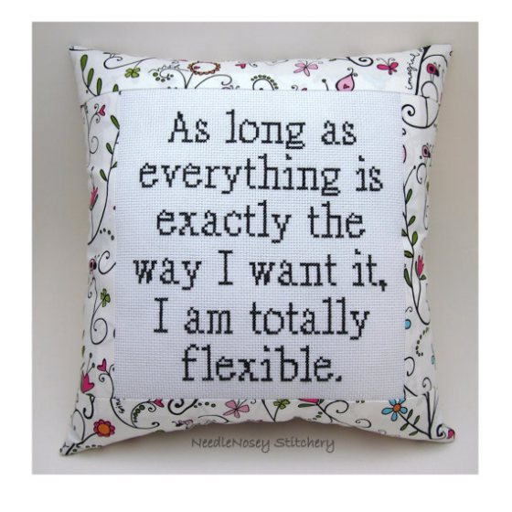
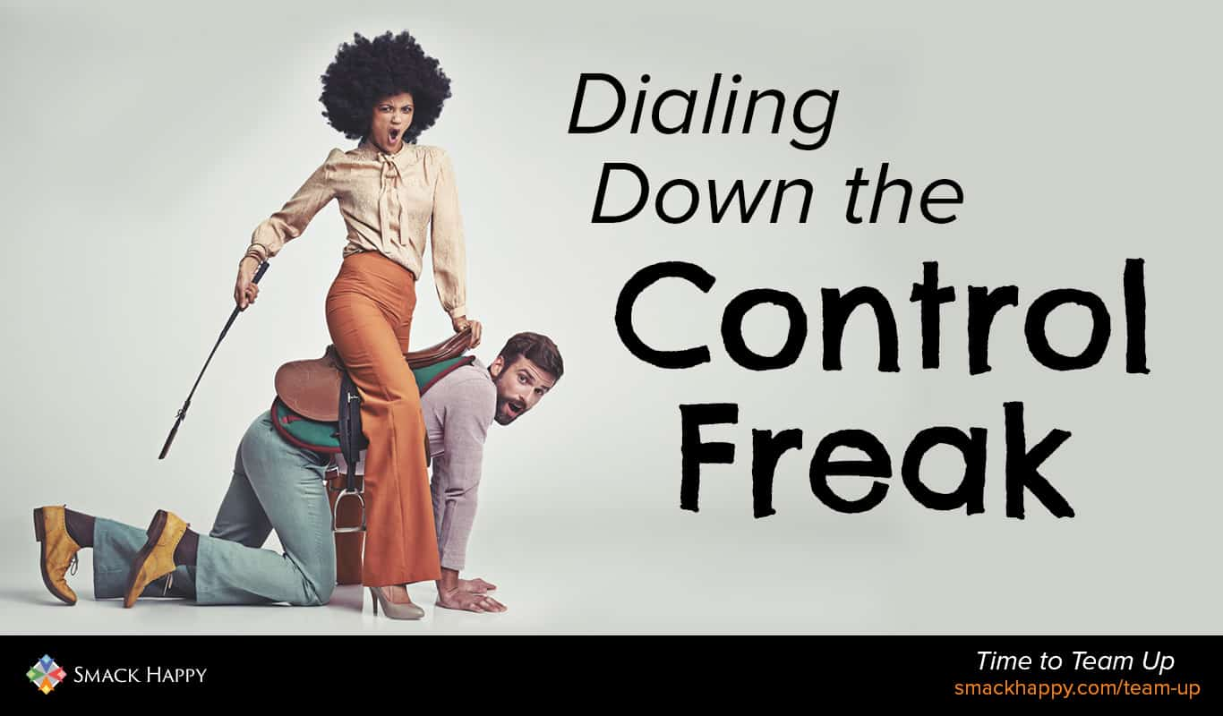
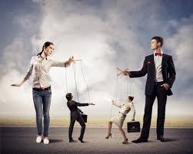
Control it!

Slide 14
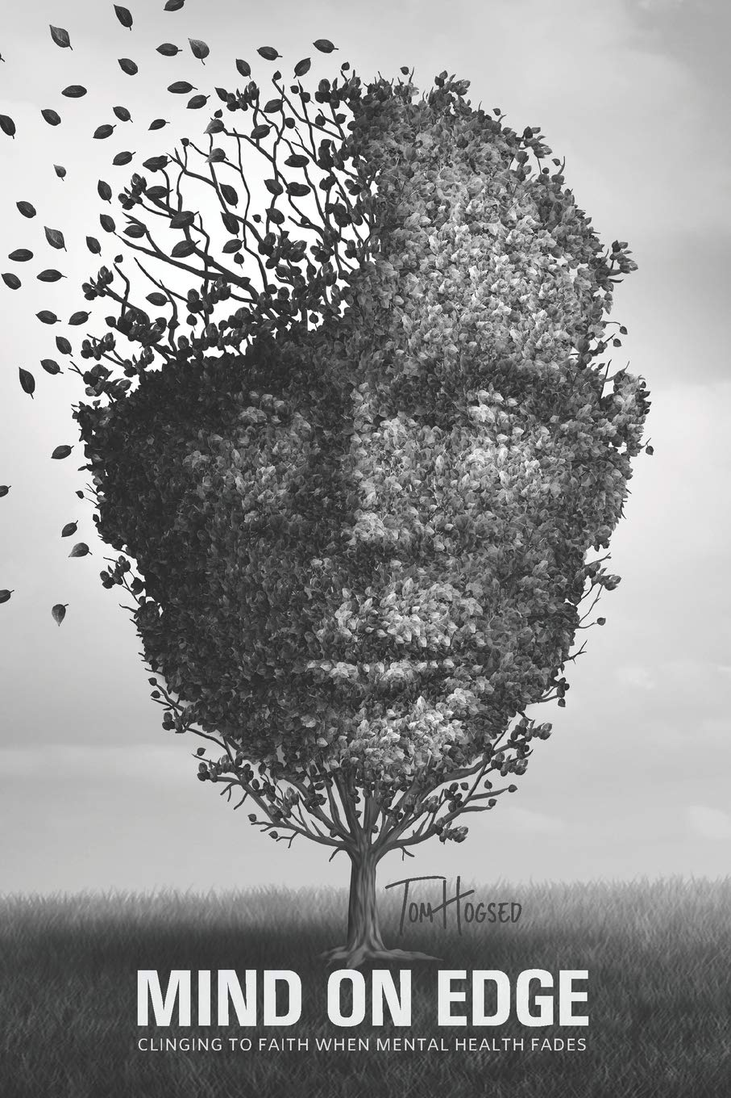
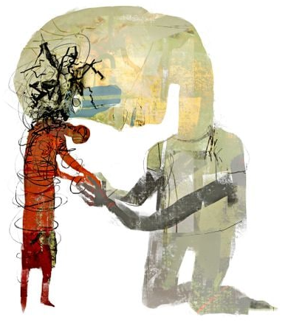
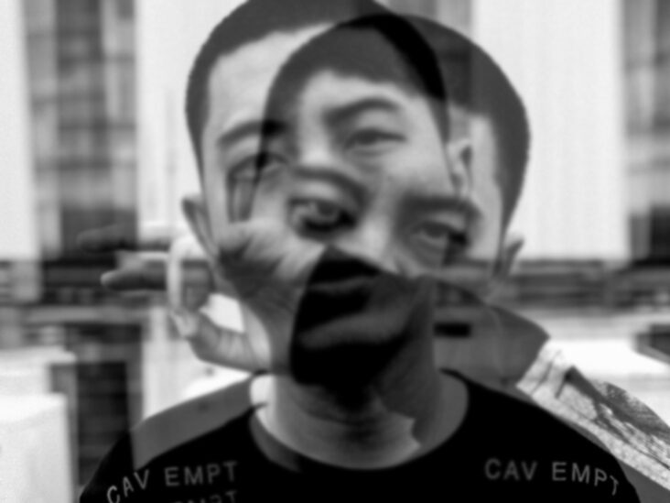
Losing it..

Slide 15
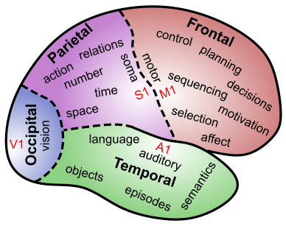

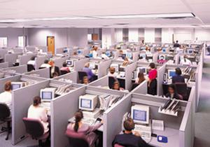
Principle #3: Control

Slide 16
The Three C’s
Compression: KISS!
Contrast: just have to outrun friend, not the bear..
Control: we are all (secret) agents!

Slide 17
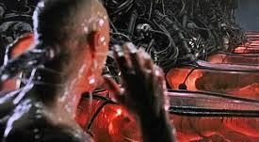
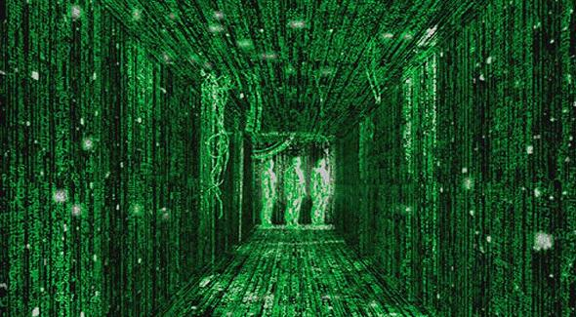
Chapter 1: Science vs. Matrix
Subjective perspective
is all we have!
Cogito Ergo Sum
And maybe, that’s it!
Science is *hard*

Slide 18
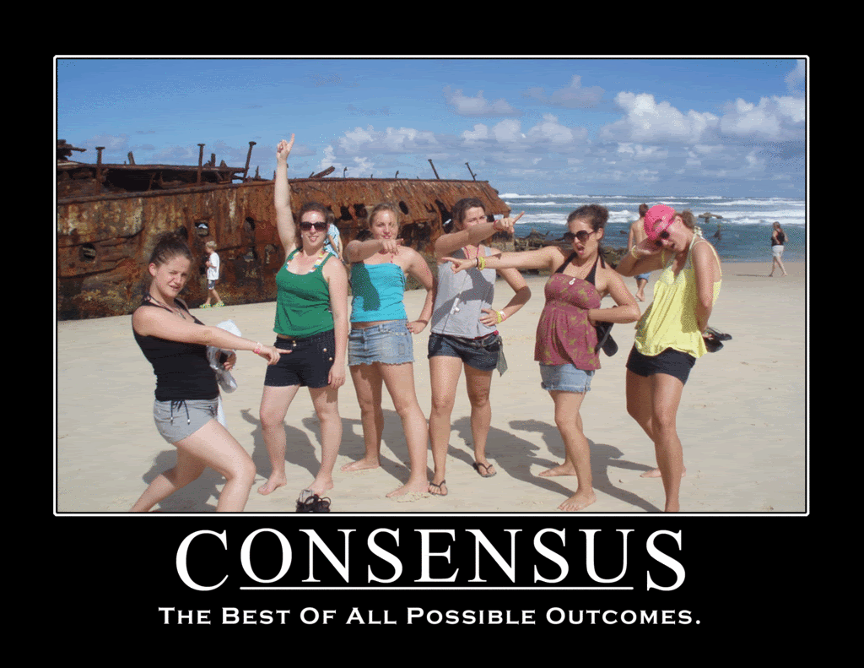

Slide 19
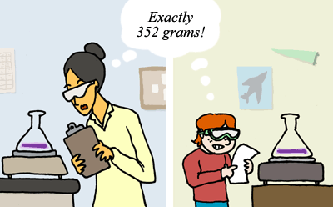
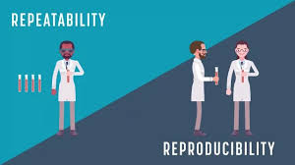
Reproducibility = Consensus

Slide 20
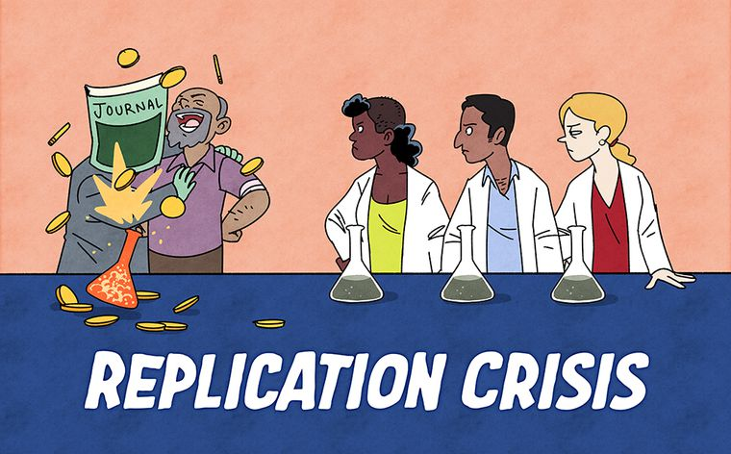

Slide 21
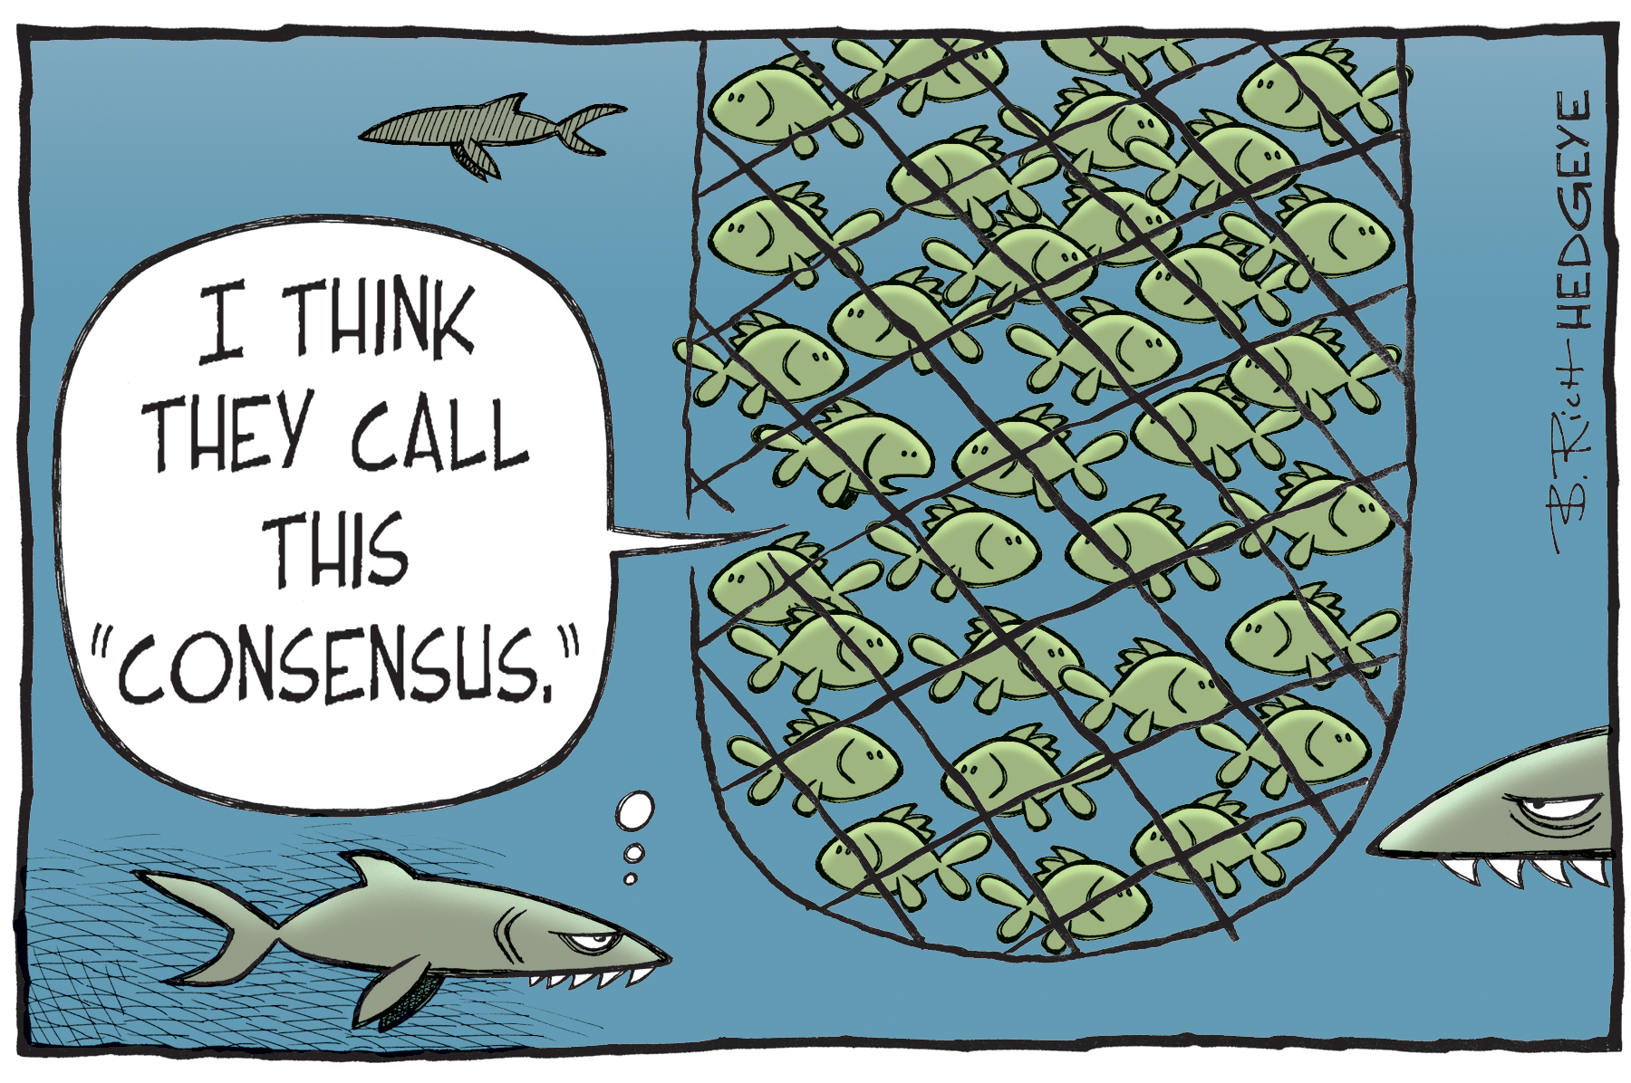
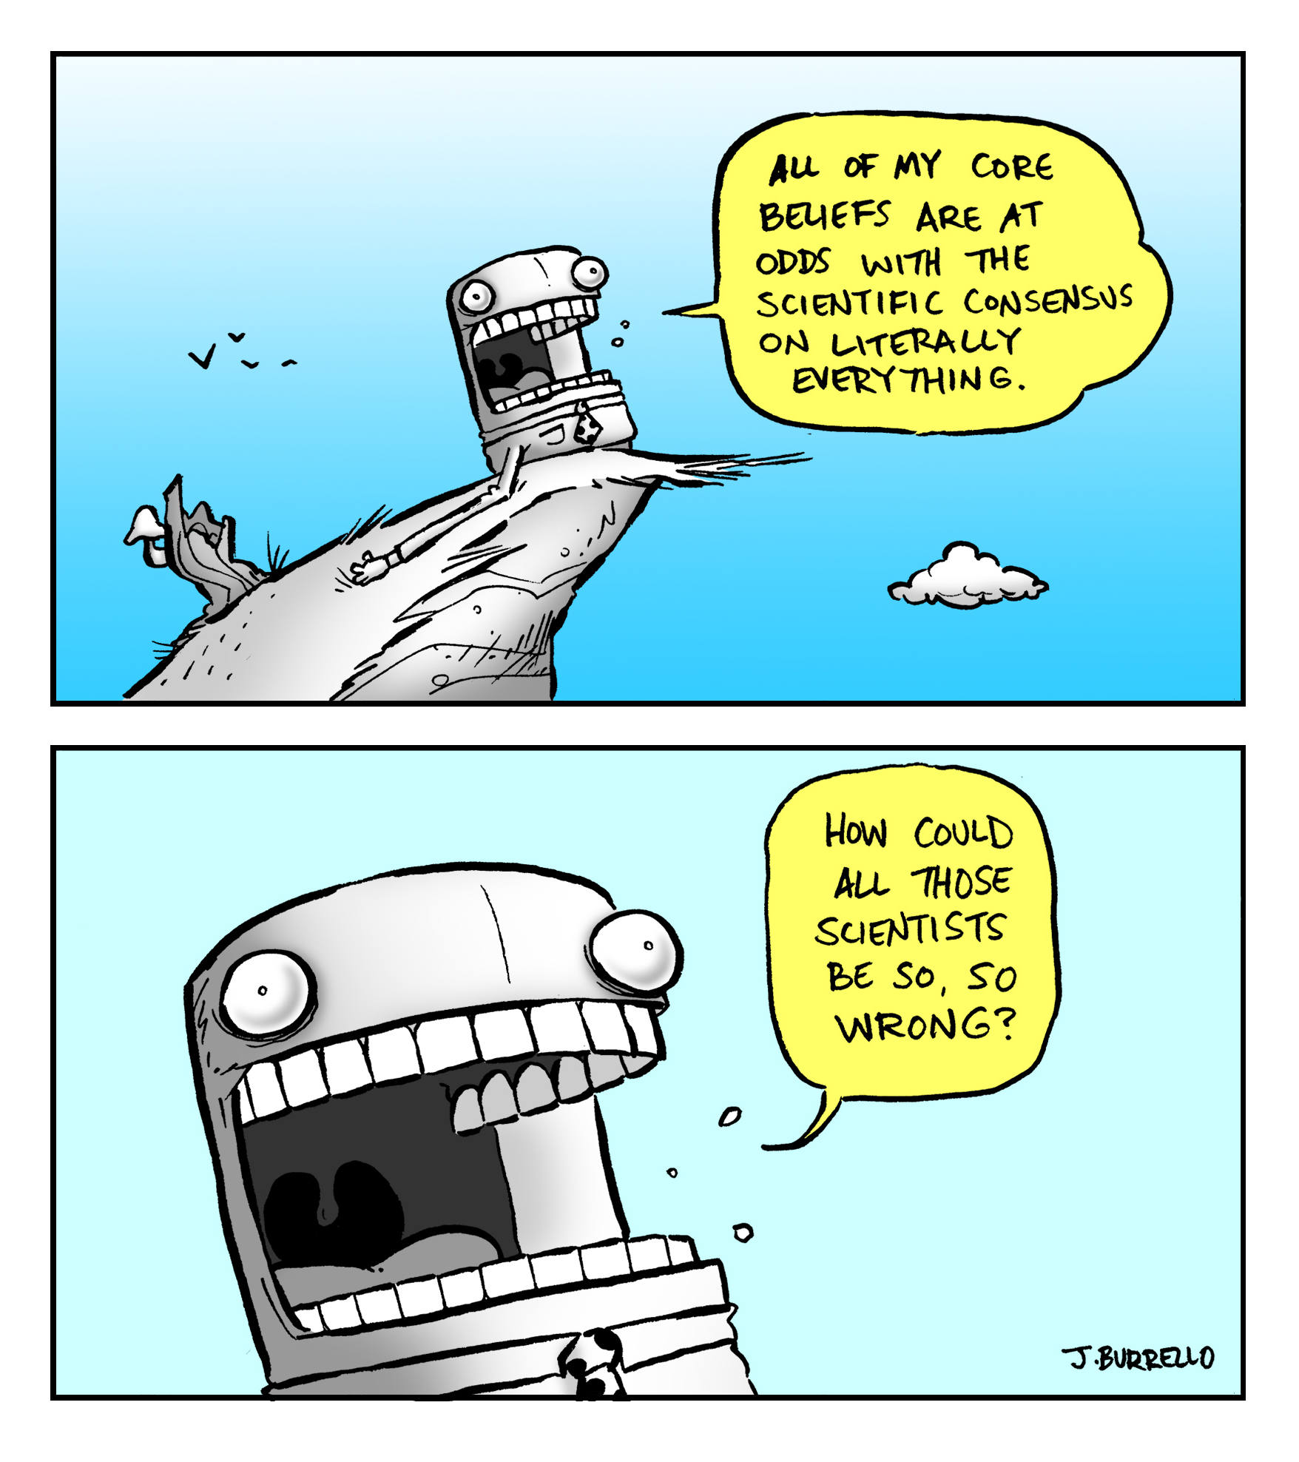
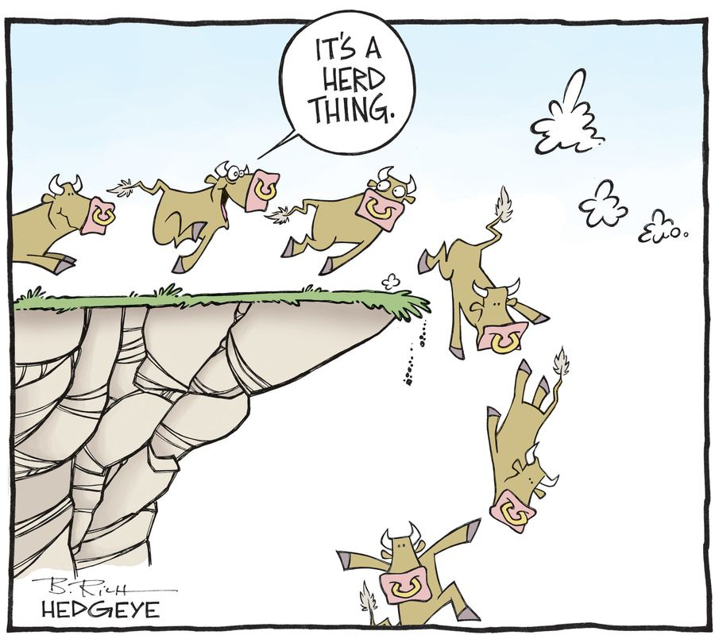
Consensus is hard..

Slide 22
Chapter 2: Neuroscience (basis of the CCC’s)

Slide 23
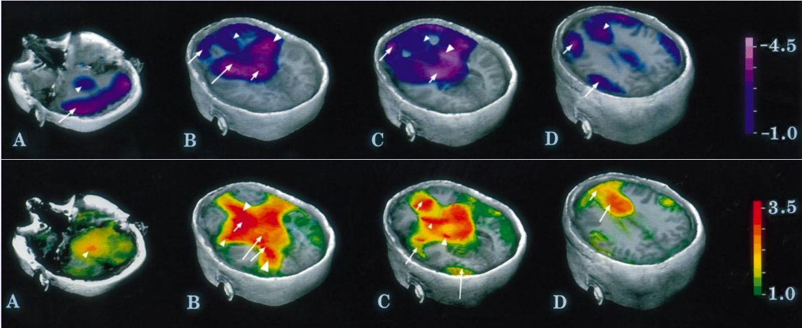
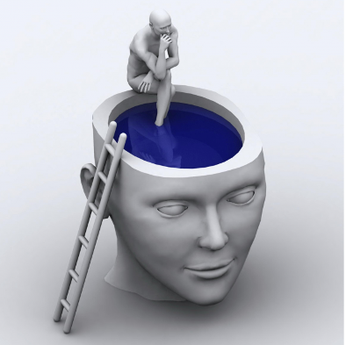
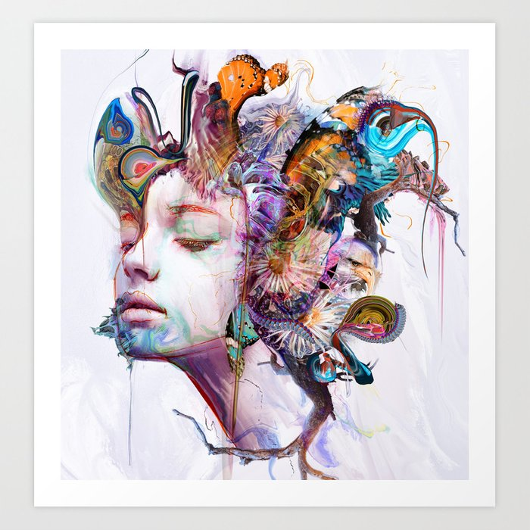
Chapter 3: Consciousness, Drugs..

Slide 24
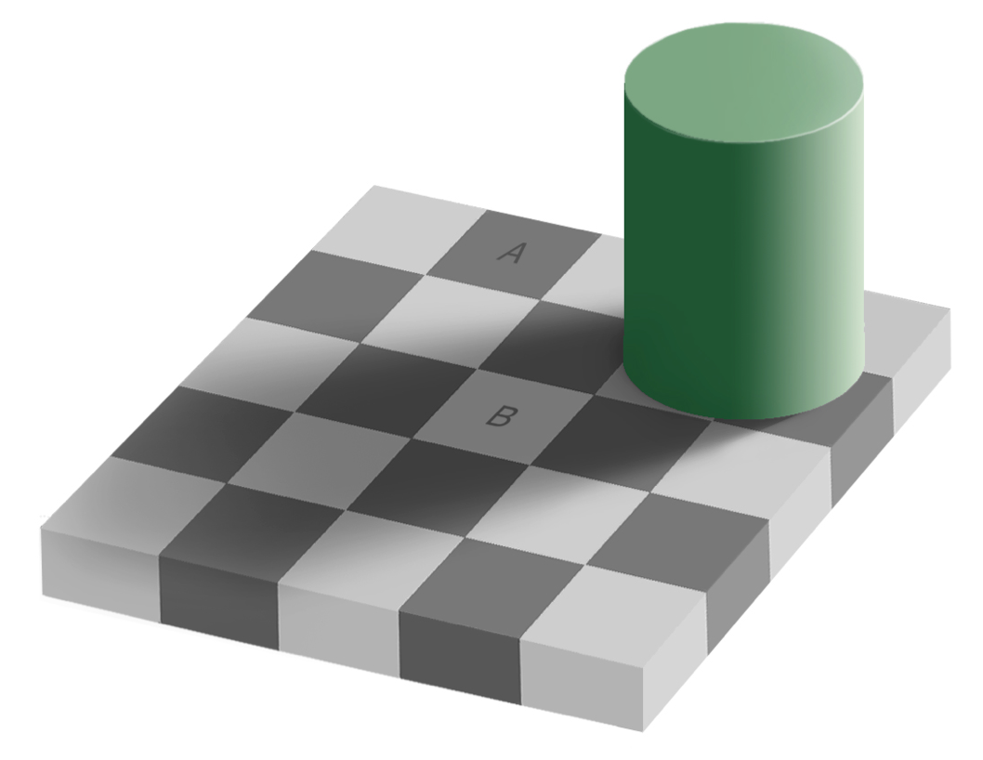
Chapter 4: Perception
Notice anything strange?
No?
That’s the point!
Btw: A == B!
We don’t see pixels
We see the world!!
Compression, Contrast drive most of perception

Slide 25
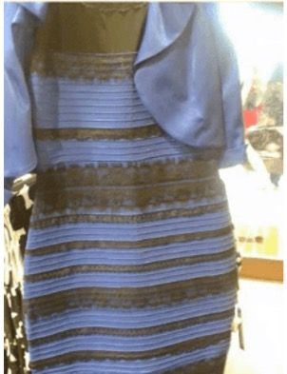
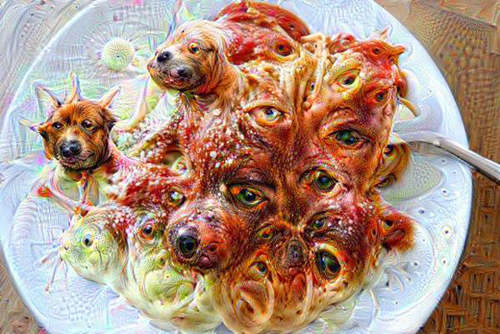
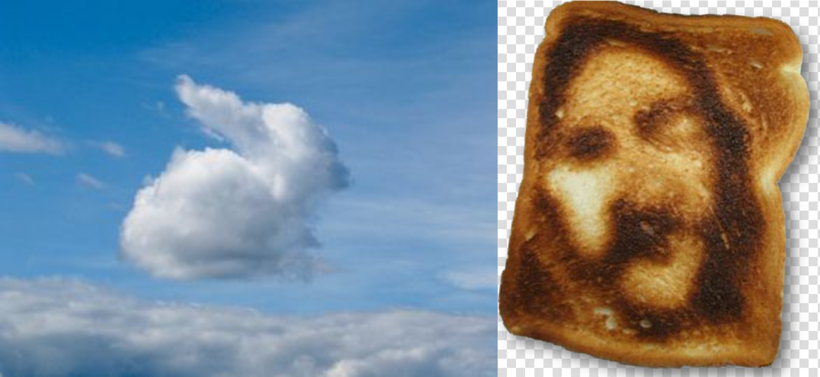
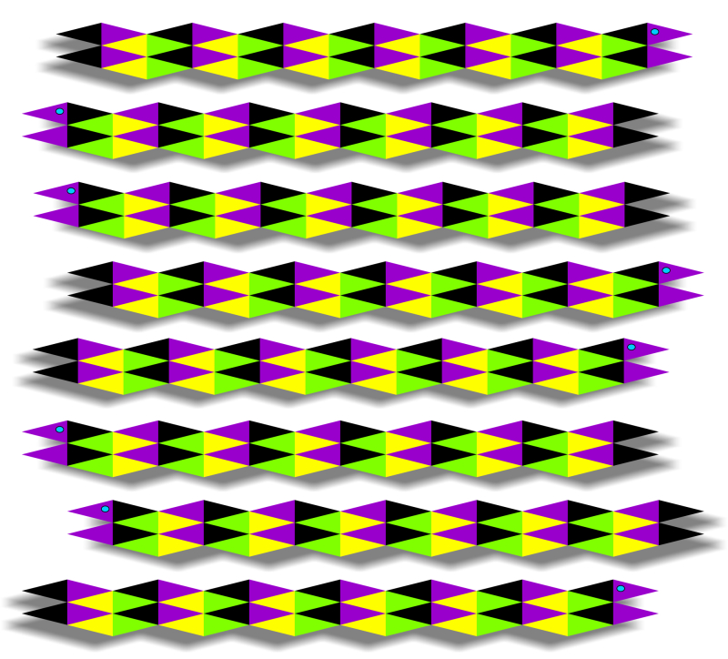
Contrast, Compression, Top-down Control

Slide 26
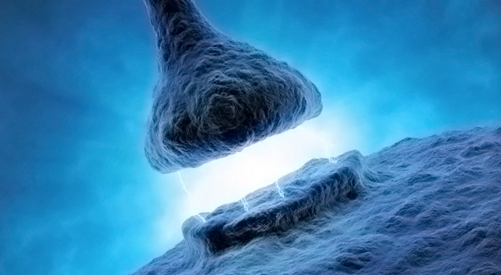
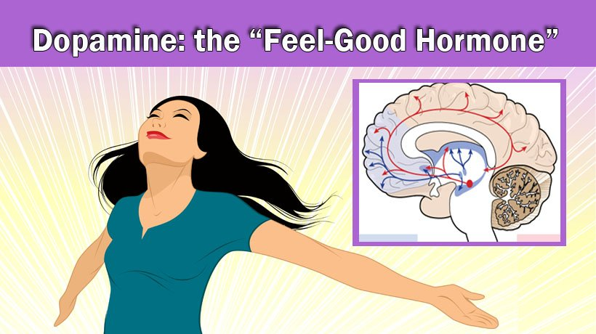
Chapter 5: Learning & Motivation
Learning is changes in synapses
Based on Contrast
Error =
prediction - outcome
And motivation!

Slide 27
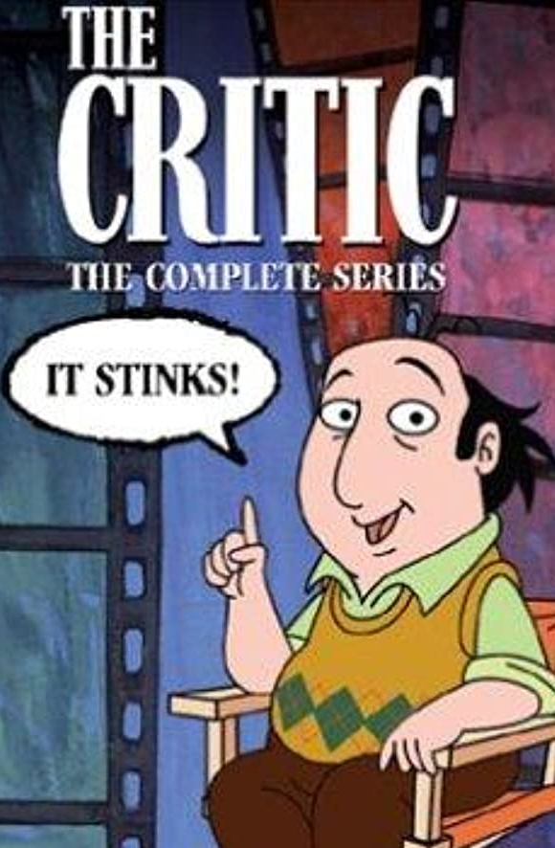
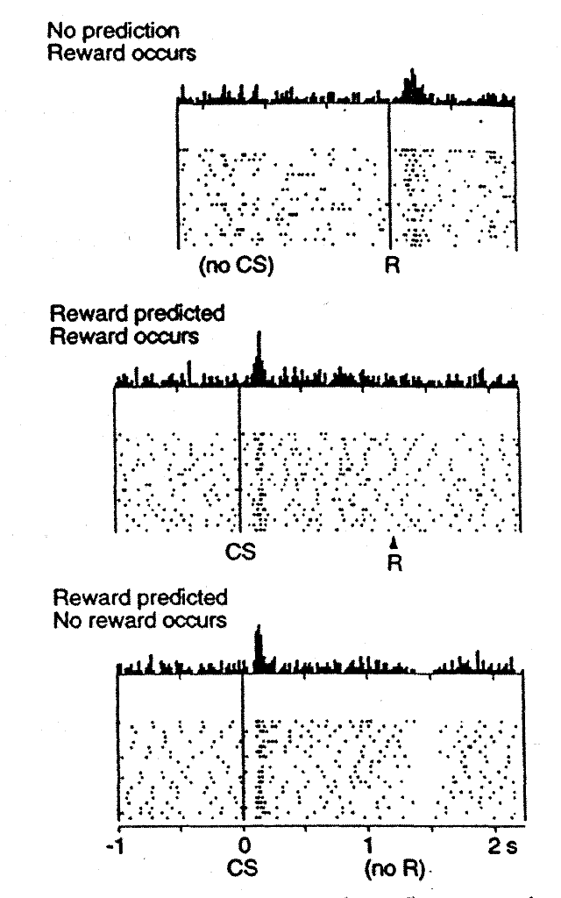

Dopamine is a Nasty Critic!

Slide 28
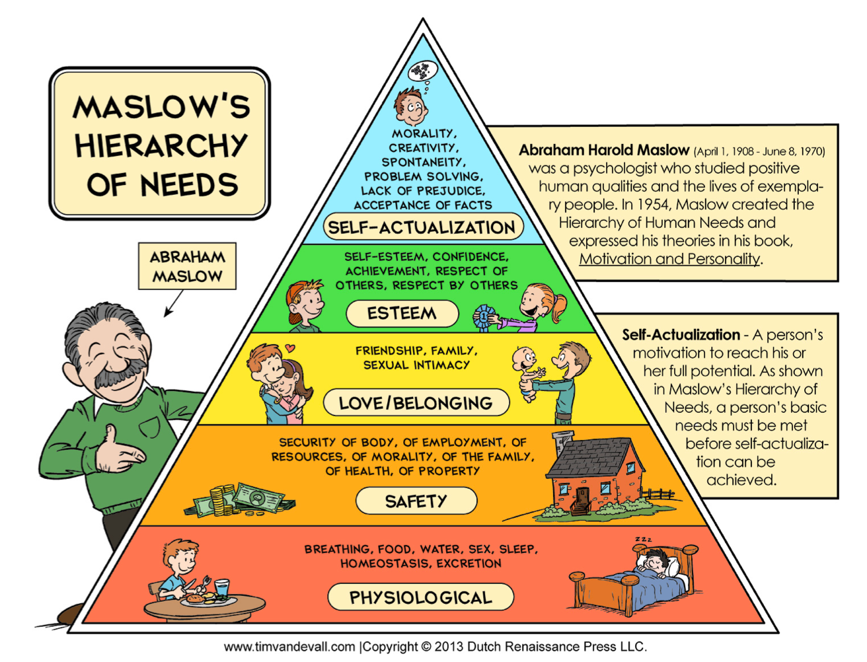
The Pyramid of Control!

Slide 29
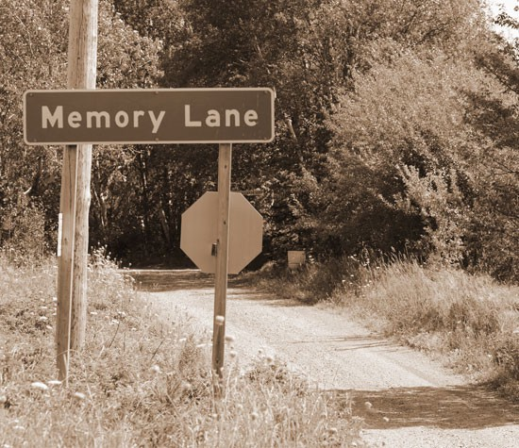



Chapter 6: Memory

Slide 30


Chapter 6: Memory
YOUR MEMORIES ARE ALL JUST
SYNAPTIC WEIGHTS!?

Slide 31
Chapter 6: Memory

Slide 32

Hippocampus gets Compressed Input

Slide 33



Chapter 7: Thinking & Control

Slide 34

Neural CPU = Turing Machine

Slide 35
PFC = Control, Working Memory

Slide 36



Motivation is the Driver..

Slide 37
Chapter 9: Social & Personality
Social comparison =
Contrast

Slide 38
You struggle with Self Control

Slide 39


Stereotypes = Compression
Everyone has internalized prevalent stereotypes, even negative ones about their own groups!
Two core dimensions: Competence (Dominance) & Warmth (Agreeableness)

Slide 40

OCEAN of Personality

Slide 41


In-Group (Love), Out-Group (Hate)

Slide 42




Chapter 10: Evolution & Development
Genes = Lego instruction pages
Base pair (G,C,T,A: Gattaca, nucleotide) 3 = one Lego brick (amino acid)
Gene = Protein = sequence of amino acids (~300 = ~900 bp’s, but genes ~27,000 bp)
Alleles = different instructions for different folks – different gene variants

Slide 43

Heritability

Slide 44

Babies are Sooooo Cute!!!!
But seriously, how do they learn so quickly (except the diapers part) and without even understanding language at the start?? It’s like they have to learn everything!?

Slide 45
Chapter 11: Disorders
Loss of control is central feature of most disorders

Slide 46

Comorbidity = Attractor Loss of control / efficacy; Social isolation

Slide 47

It’s Rough Out There..
Anxiety
Depression
Drug use
Alcohol
Bipolar
Eating
Schizophrenia

Slide 48

Therapy is Safe Social Bond Rebuilds Self-Efficacy, Control

Slide 49

Therapy (CBT) >= SSRI!
For most anxiety, depression cases.
Has no side effects!
But is expensive!

Slide 50
The Three C’s
Compression: KISS!
Contrast: just have to outrun friend, not the bear..
Control: we are all (secret) agents!

